Slide 1
Mathematics for Cryptography: prime number and related congruence equtions
Dr. B C Dhara
Department of Information Technology
Jadavpur University

Slide 2
Objectives
Prime numbers and applications in cryptography
Primality test algorithms and their efficiencies
Factorization algorithms and their applications in cryptography
Chinese remainder theorem and its application
Quadratic congruence
Modular exponentiation and logarithm
B C Dhara, Dept. of IT, JU

Slide 3
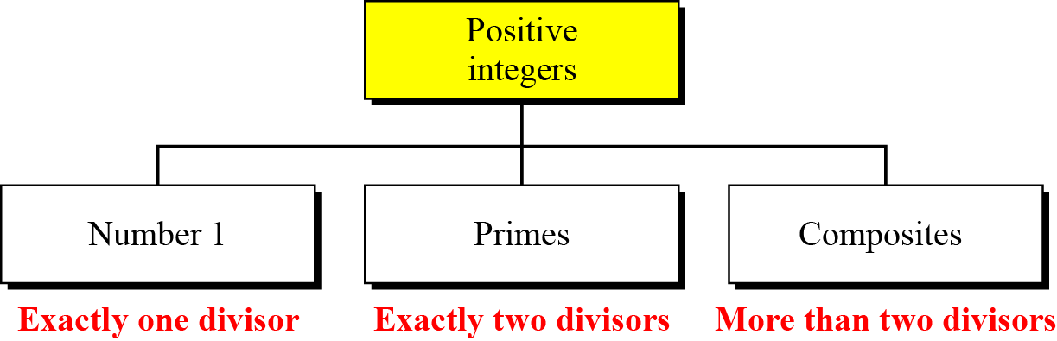
Primes
Asymmetric-key cryptography uses primes extensively
A positive integer is prime if and only if it is divisible by exactly two positive integers, 1 and itself
  Otherwise the number is composite
B C Dhara, Dept. of IT, JU

Slide 4

Prime: example
List the primes smaller than 10.
Solution
There are four primes less than 10: 2, 3, 5, and 7. It is interesting to note that the percentage of primes in the range 1 to 10 is 40%. The percentage decreases as the range increases.
B C Dhara, Dept. of IT, JU

Slide 5
Coprimes
Two positive integers a and b are relatively prime or coprime, if gcd(a,b)=1
  1 is coprime to all positive integers
  If p is a prime, it is coprime to 1 to p-1
  Z_{n}* is the set of positive integers coprime to n
  Z_{p}*={1,2,…,p-1}
B C Dhara, Dept. of IT, JU

Slide 6
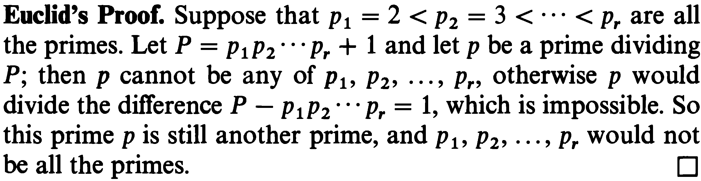
Cardinality of primes
Is there a finite number of primes or is the list infinite?
Given n, how many primes are smaller than or equal to n?
  Suppose, set of primes is finite and p is the largest prime number
  Multiply all the prime numbers: P=2×3×…×p
  Let q, a prime number ≤ p. So, q divides P
  P+1 can not have any prime factor q ≤ p
    If has, q divides P+1 ➔ q divides (P+1)-P=1, a contradiction, i.e., q > p ➔ p cannot be largest prime number
There is an infinite number of primes
As a trivial example, assume that the only primes are in the set
{2, 3, 5, 7, 11, 13, 17}. Here P = 510510 and P + 1 = 510511. However, 510511 = 19 × 97 × 277; none of these primes were in the
original list. Therefore, there are three primes greater than 17.
B C Dhara, Dept. of IT, JU

Slide 7
Number of Primes
Number of prime numbers less or equal to n is
Gauss discovered lower limit
Lagrange discovered upper limit
Find the number of primes less than 1,000,000.
Solution
The approximation gives the range 72,383 to 78,543. The actual number of primes is 78,498.
B C Dhara, Dept. of IT, JU

Slide 8
Checking for Primeness
Given a number n, how can we determine if n is a prime?
The answer is that we need to see if the number is divisible by all primes less than √n
  This is inefficient, but go to start
Is 97 a prime?
The floor of √97 = 9. The primes less than 9 are 2, 3, 5, and 7. 97 is not divisible by any of these numbers, so 97 is a prime.
Is 301 a prime?
The floor of √301 = 17. We need to check 2, 3, 5, 7, 11, 13, and 17. The numbers 2, 3, and 5 do not divide 301, but 7 does, so 301 is not a prime.
B C Dhara, Dept. of IT, JU

Slide 9
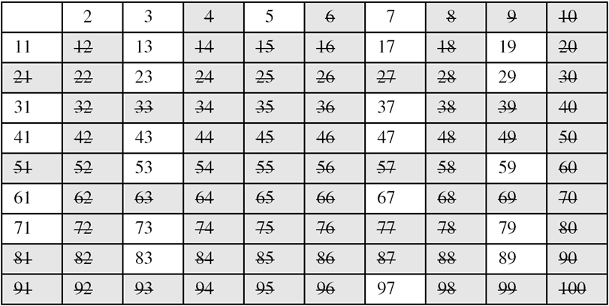
Sieving method
Find all prime numbers less than 100, say?
B C Dhara, Dept. of IT, JU

Slide 10
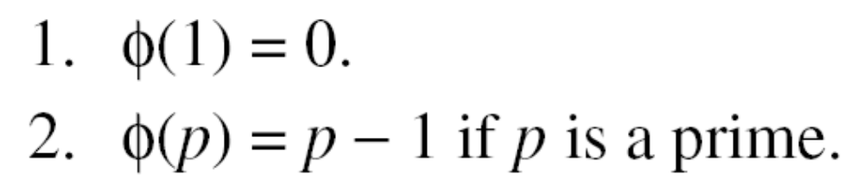
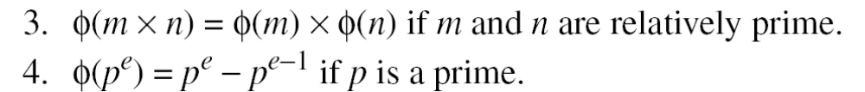
Euler’s phi-function, φ (n)
Euler’s phi-function, φ (n), which is sometimes called the Euler’s totient function plays a very important role in cryptography
Z_{n}* contains the number smaller than n and relatively prime to n
B C Dhara, Dept. of IT, JU

Slide 11
Euler’s phi-function, φ (n) (contd…)
We can combine the above four rules to find the value of φ(n). For example, if n can be factored as
n = p₁^{e1} × p₂^{e2} × … × p_{k}^{ek}
then we combine the third and the fourth rule to find
The difficulty of finding φ(n) depends on the difficulty of finding the factorization of n.
B C Dhara, Dept. of IT, JU

Slide 12
Euler’s phi-function, φ (n): example
Interesting point: If n > 2, the value of φ(n) is even.
What is the value of φ(13)? ➔ φ(13) = (13 −1) = 12
What is the value of φ(10)? ➔ φ(10) = φ(2) × φ(5) = 1 × 4 = 4
What is the number of elements in Z₁₄*? ➔ φ(14) = φ(7) × φ(2) = 6 × 1 = 6. The members are 1, 3, 5, 9, 11, and 13.
Can we say that φ(49) = φ(7) × φ(7) = 6 × 6 = 36?
No. The third rule applies when m and n are relatively prime. Here 49 = 7². We need to use the fourth rule: φ(49) = 7² − 7¹ = 42.
What is the value of φ(240)? ➔ 240 = 2⁴ × 3¹ × 5¹. Then,
φ(240) = (2⁴ −2³) × (3¹ − 3⁰) × (5¹ − 5⁰) = 64
B C Dhara, Dept. of IT, JU

Slide 13
Fermat’s Little Theorem
First version: p is a prime number a does not divides p then
Second version: (remove the restriction on a) p is a prime number a is an integer then
Useful to find exponent
a^{p − 1} ≡ 1 mod p
a^{p} ≡ a mod p
B C Dhara, Dept. of IT, JU

Slide 14
Fermat’s Little Theorem (contd…)
Find the result of 6¹⁰ mod 11 → 6¹⁰ mod 11 = 1, this is the first version of Fermat’s little theorem where p = 11
Find the result of 3¹² mod 11.
a⁻¹ mod p = a ^{p − 2} mod p
Multiplicative Inverses
B C Dhara, Dept. of IT, JU

Slide 15
Euler’s Theorem
A generalization of Fermat’s little theorem
First Version: gcd(a,n)=1
Second version: relaxed the condition gcd(a,n)=1
Useful to find exponent
a^{φ(n)} ≡ 1 (mod n)
a ^{k × φ(n) + 1} ≡ a (mod n)
B C Dhara, Dept. of IT, JU

Slide 16
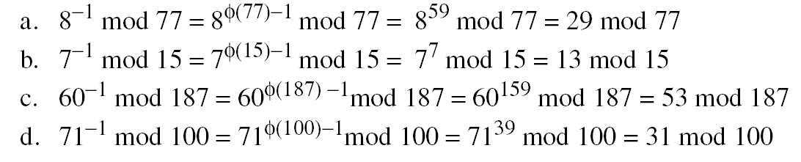
Application of Euler’s Theorem
Find the result of 6²⁴ mod 35 ➔ 6²⁴ mod 35 = 6^{φ(35)} mod 35 = 1
Find the result of 20⁶² mod 77 ➔ φ(77) = 6 × 10 = 66
20⁶² mod 77 = (20 mod 77) (20^{φ(77)} ⁺ ¹ mod 77) mod 77 [2nd version]
= (20)(20) mod 77 = 15
Multiplicative Inverses
Euler’s theorem can be used to find multiplicative inverses modulo a composite
a⁻¹ mod n = a^{φ(n)−1} mod n
B C Dhara, Dept. of IT, JU

Slide 17
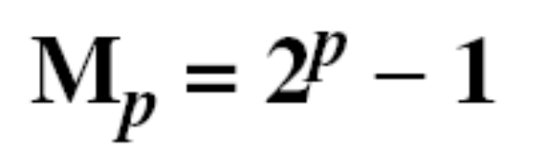
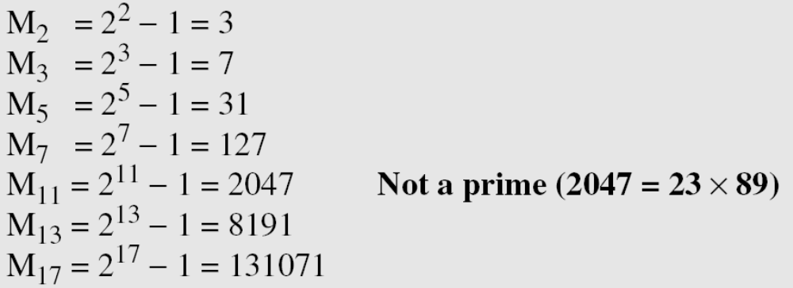
Generating primes: Mersenne Primes
A formula that could generate a prime
A number in the form M_{p} = 2^{p} − 1 is called a Mersenne number and may or may not be a prime.
B C Dhara, Dept. of IT, JU

Slide 18

Generating primes: Fermat Primes
F₀ = 3
F₁ = 5
F₂ = 17
F₃ = 257
F₄ = 65537
F₅ = 4294967297 = 641 × 6700417 Not a prime
B C Dhara, Dept. of IT, JU

Slide 19
PRIMALITY TESTING
How a large prime number is to be produced?
  We can use Fermat’s or Mersenne’s method, but they may fail
  Choose a large random number and test weather it is prime or not.
    This is a challenging task
    Two types of algorithms deal with this problem
      Deterministic algorithm and probabilistic algorithm and some are hybrid
      Deterministic gives correct answer but less efficient
      Probabilistic gives correct answer most of time
B C Dhara, Dept. of IT, JU

Slide 20
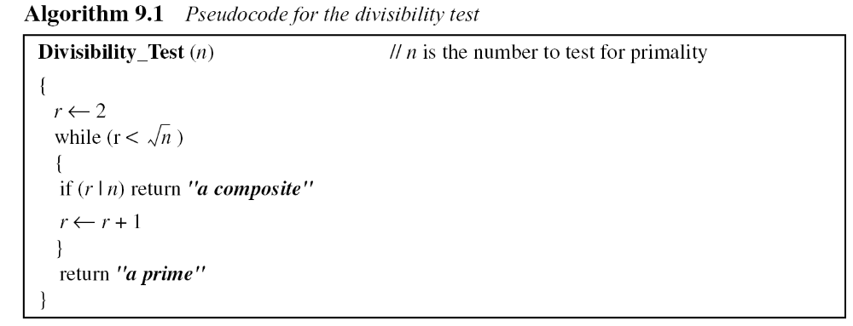
Deterministic Algorithms
Divisibility Algorithm
The algorithm can be improved by
  considering odd numbers only
  A table of primes between 2 and √n
The loop iterates √n times
In each iteration: number of operations 2 (division and increment)
If we assume only bit-operation, number of operations is O(√2^{nb}) = O(2^{nb/2}), an exponential complexity
B C Dhara, Dept. of IT, JU

Slide 21
Divisibility Algorithm: example
Assume n has 200 bits. What is the number of bit operations needed to run the divisibility-test algorithm?
Solution
The bit-operation complexity of this algorithm is 2^{nb/2}. This means that the algorithm needs 2¹⁰⁰ bit operations. On a computer capable of doing 2³⁰ bit operations per second, the algorithm needs 2⁷⁰ seconds to do the testing (forever).
B C Dhara, Dept. of IT, JU

Slide 22
Probabilistic algorithms
A probabilistic algorithm does not give any guarantee about the correctness of the result
  The probability of error can be made so small that it is almost certain that the answer returned by the algorithm is correct
  A probabilistic algorithm returns either a prime or a composite
    If the tested number is prime, algorithm definitely returns a prime
    If the tested number is actually composite, it returns a composite with probability 1-ε or it may return prime with probability ε
The probability of mistake can be reduced:
if we run the algorithm more than once with different parameters
or using different methods
if the algorithm runs m times, the probability of error may reduced to ε^{m}
B C Dhara, Dept. of IT, JU

Slide 23
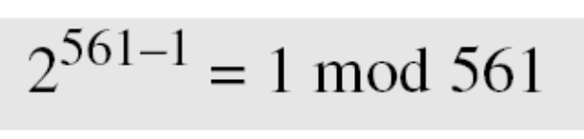
Fermat Test
If n is a prime, a^{n−1} ≡ 1 mod n
If n is a composite, it is possible that a^{n−1} ≡ 1 mod n
Does the number 561 pass the Fermat test?
Solution
Use base 2:
The number passes the Fermat test, but it is not a prime, because 561 = 33 × 17.
B C Dhara, Dept. of IT, JU

Slide 24
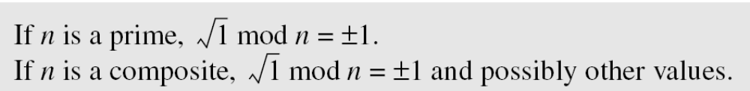
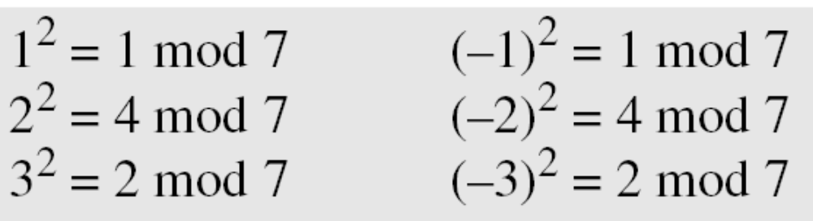
Square Root Test
What are the square roots of 1 mod n if n is 7 (a prime)?
Solution
The only square roots are 1 and −1. We can see that
Note that we don’t have to test 4, 5 and 6 because 4 = –3 mod 7,
5 = –2 mod 7 and 6 = –1 mod 7.
B C Dhara, Dept. of IT, JU

Slide 25
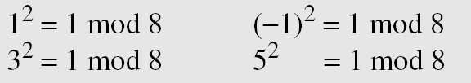
Square Root Test (contd…)
What are the square roots of 1 mod n if n is 8 (a composite)?
Solution
There are four solutions: 1, 3, 5, and 7 (which is −1). We can see that
If x²=1 mod n for x ≠ ±1, number is composite
B C Dhara, Dept. of IT, JU

Slide 26
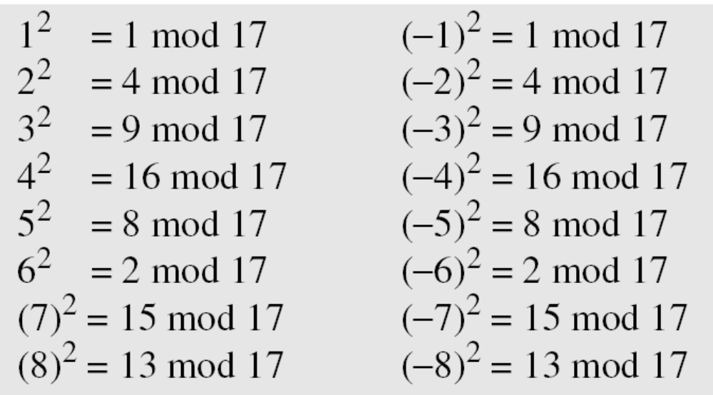
Square Root Test (contd…)
What are the square roots of 1 mod n if n is 17 (a prime)?
Solution: There are only two solutions: 1 and −1
B C Dhara, Dept. of IT, JU

Slide 27
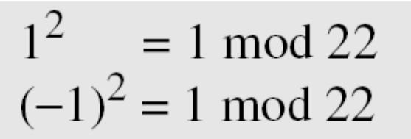
Square Root Test (contd…)
What are the square roots of 1 mod n if n is 22 (a composite)?
Solution
Surprisingly, there are only two solutions, +1 and −1, although 22 is a composite.
According to the method 22 is prime.
This test when tell us that number is composite, it is correct
  Difficult to do the test
B C Dhara, Dept. of IT, JU

Slide 28
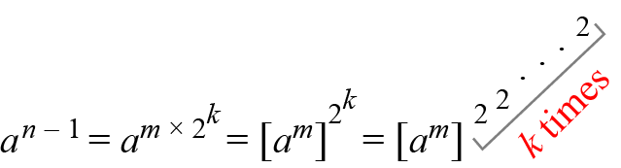
Miller-Rabin Test
Combines the Fermat test and the square root test to find a strong pseudoprime (a prime with a very high probability)
n-1 = m × 2^{k} (m is odd)
Idea of Fermat test on base ‘a’
B C Dhara, Dept. of IT, JU

Slide 29
Miller-Rabin Test (contd…)
a^{n-1} (mod n) can be computed in one step
Here, it is done in k+1 steps
  Advantage: in each step the square root test can be applied and it the test fails then STOP and declare n as composite
  In testing:
    if number is 2 only even prime
    If other even number composite
    Otherwise, number is odd. So, n-1 (even) can be expressed as n-1= m2^{k} for k>0
This method returns either composite or probably prime
B C Dhara, Dept. of IT, JU

Slide 30
Miller-Rabin Test (contd…)
Select a random integer from [2 n-2]
Compute T= a^{m} (mod n)
  if T = ±1 mod n, n is probably prime and STOP
  Else for i=1 to k-1
    T = T² mod n
    If T = +1, n is a composite number STOP
    If T=-1, n is probably prime and STOP
  n is composite
B C Dhara, Dept. of IT, JU

Slide 31
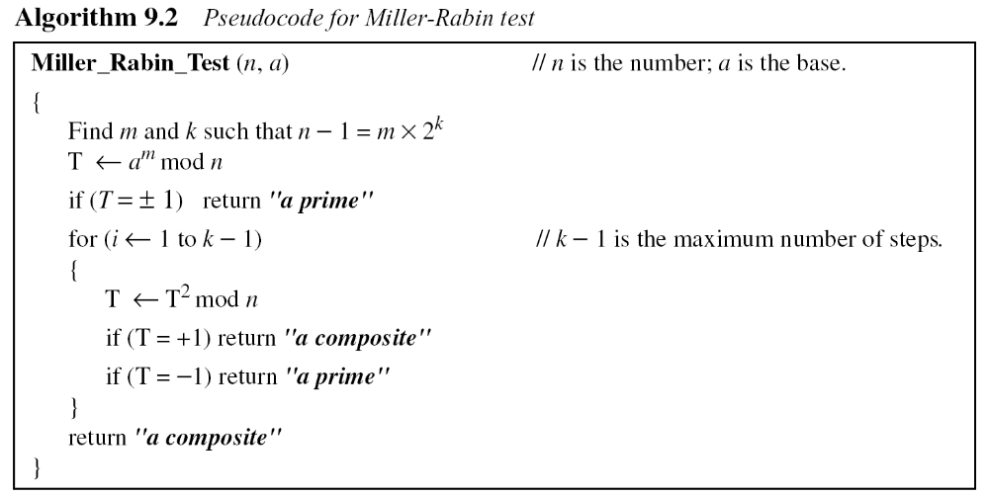
Pseudocode for Miller-Robin test
B C Dhara, Dept. of IT, JU

Slide 32
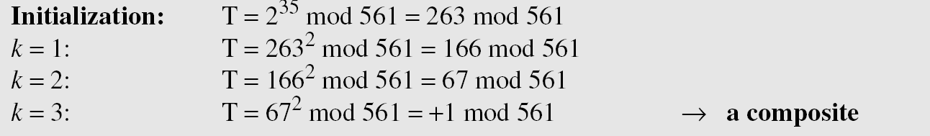
Example: Miller-Robin test
Does the number 561 pass the Miller-Rabin test?
Solution
561 − 1 = 35 × 2⁴, which means m = 35, k = 4, and select a = 2.
561= 3 * 187
B C Dhara, Dept. of IT, JU

Slide 33
Example: Miller-Robin test (contd…)
We already know that 27 is not a prime. Let us apply the Miller-Rabin test.
Solution
27 − 1 = 13 × 2¹, which means that m = 13, k = 1, and let a = 2
In this case, because k − 1 = 0, we should do only the initialization step: T = 2¹³ mod 27 = 11 mod 27
However, because the algorithm never enters the loop, it returns a composite.
9.<number>
B C Dhara, Dept. of IT, JU

Slide 34
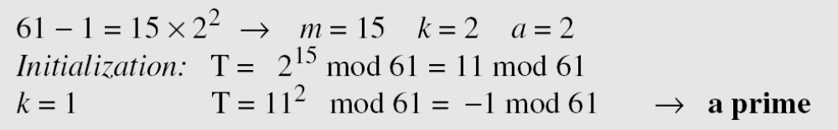
Example: Miller-Robin test (contd…)
We know that 61 is a prime, let us see if it passes the Miller-Rabin test.
Solution
We use base 2.
B C Dhara, Dept. of IT, JU

Slide 35
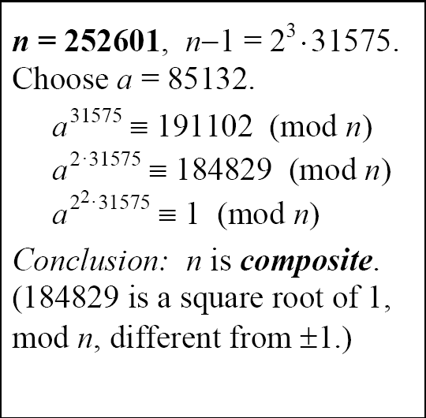
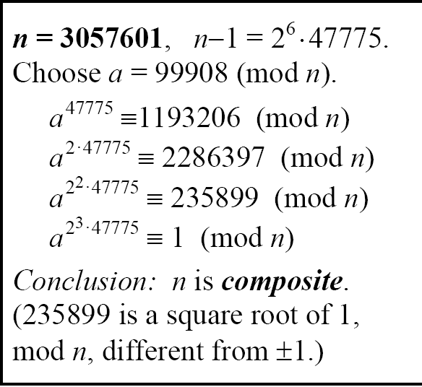
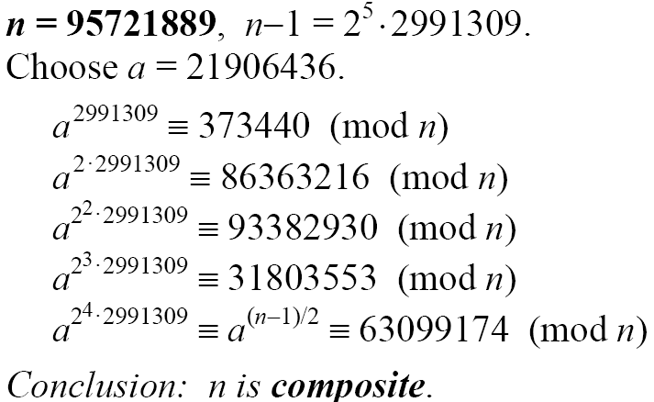
B C Dhara, Dept. of IT, JU

Slide 36
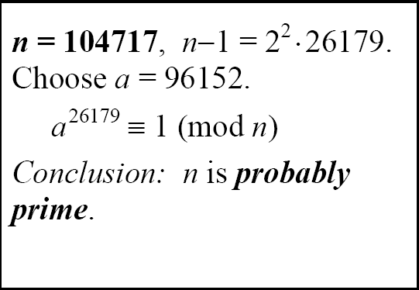
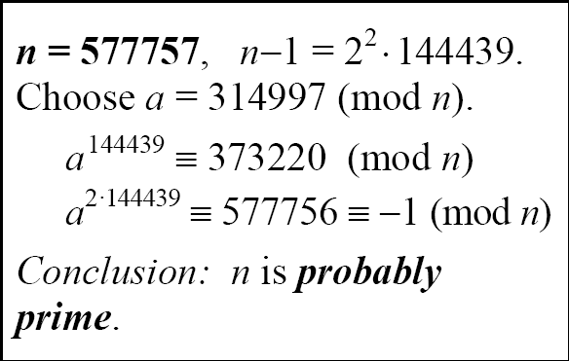
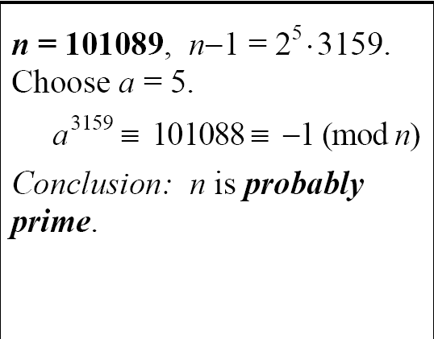
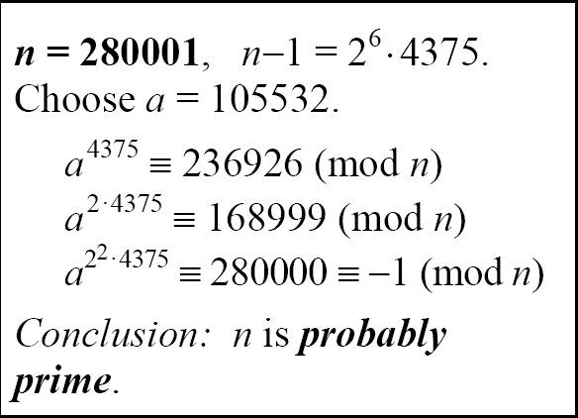
B C Dhara, Dept. of IT, JU

Slide 37
Recommended Primality Test
The most popular primality test is a combination of the divisibility test and the Miller-Rabin test.
B C Dhara, Dept. of IT, JU

Slide 38
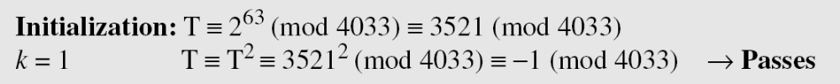
Example: Recommended Primality Test
The number 4033 is a composite (37 × 109). Does it pass the recommended primality test?
Solution
1. Perform the divisibility tests first. The numbers 2, 3, 5, 7, 11, 17,
and 23 are not divisors of 4033.
2. Perform the Miller-Rabin test with a base of 2, 4033 − 1 = 63 ×
26, which means m is 63 and k is 6.
No comments
B C Dhara, Dept. of IT, JU

Slide 39
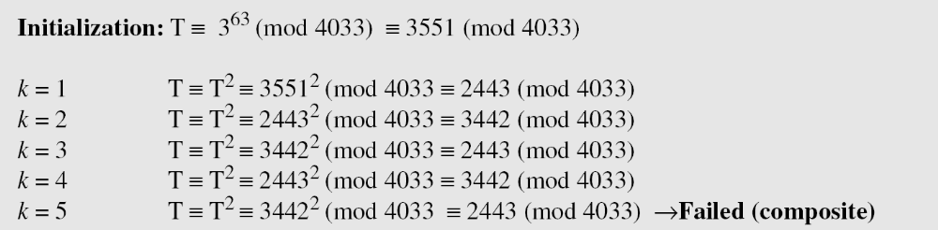
Example: Recommended Primality Test (contd…)
3. But we are not satisfied. We continue with another base, 3.
B C Dhara, Dept. of IT, JU

Slide 40

AKS primality test
Given an integer n (≥ 2) and integer a coprime to n, n is prime if and only if the polynomial congruence relation (x+a)^{n} ≡ x^{n}+a mod n
AKS primality test (Agrawal–Kayal–Saxena primality test) is deterministically correct for any general number
The maximum running time of the algorithm can be expressed as a polynomial over the number of digits in the target number,
B C Dhara, Dept. of IT, JU

Slide 41
AKS primality test (contd...)
The algorithm is guaranteed to distinguish deterministically whether the target number is prime or composite
The correctness of AKS is not conditional on any subsidiary unproven hypothesis
Assume n has 200 bits. What is the number of bit operations needed to run the AKS algorithm?
Solution
This algorithm needs only (log₂200)¹² = 39,547,615,483 bit operations. On a computer capable of doing 1 billion bit operations per second, the algorithm needs only 40 seconds.
B C Dhara, Dept. of IT, JU

Slide 42
FACTORIZATION
Factorization plays a very important role in the security of several public-key cryptosystems
Topics discussed in this section:
Fundamental Theorem of Arithmetic
Factorization Methods
Fermat Method
Pollard p – 1 Method
Pollard rho Method
More Efficient Methods
B C Dhara, Dept. of IT, JU

Slide 43
Fundamental Theorem of Arithmetic
Fundamental theorem of arithmetic (FTA), also called the unique factorization theorem or the unique-prime-factorization theorem, states that
Every integer greater than 1either is a prime number itself or can be represented as the product of prime numbers; moreover, this representation is unique, up to (except for) the order of the factors
  For example, 1200 = 2⁴ × 3¹ × 5² = 5×2×5×2×3×2×2 = ...
B C Dhara, Dept. of IT, JU

Slide 44

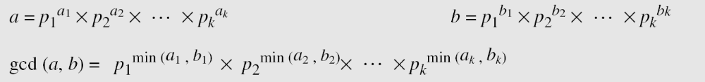
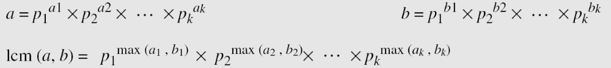
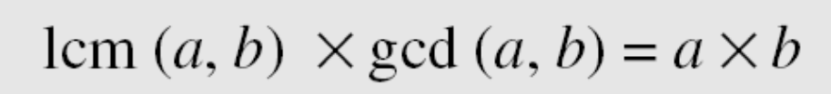
FTA (contd...)
Greatest Common Divisor
Least Common Multiplier
B C Dhara, Dept. of IT, JU

Slide 45
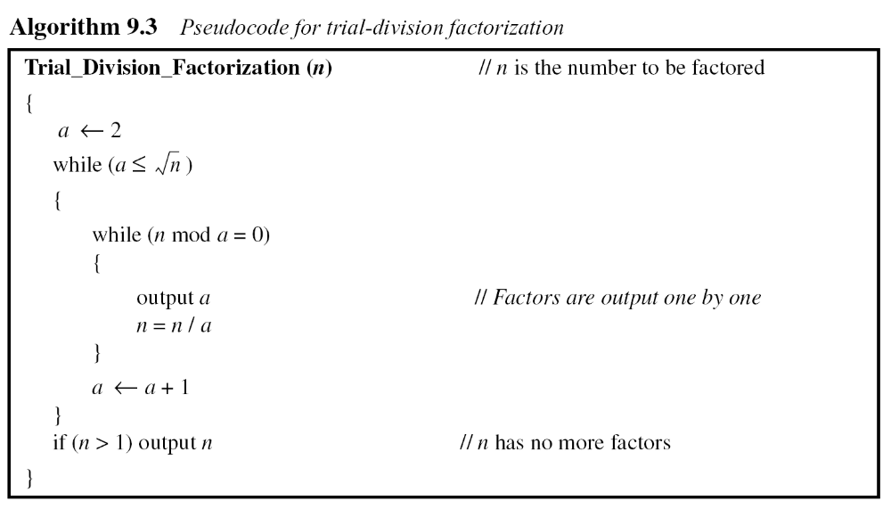
Factorization methods
Trial Division Method
Exponential complexity algorithm
B C Dhara, Dept. of IT, JU

Slide 46
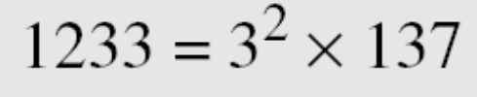
Example: Trial Division Method
Use the trial division algorithm to find the factors of 1233.
Solution
We run a program based on the algorithm and get the following result.
Use the trial division algorithm to find the factors of 1523357784.
Solution
We run a program based on the algorithm and get the following result.
B C Dhara, Dept. of IT, JU

Slide 47
Fermat Method
this method factorizes n into two integers a and b (not necessary prime) so that n = a×b
Try to find a and b close to each other
If a ≥ √n then b ≤ √n
B C Dhara, Dept. of IT, JU

Slide 48
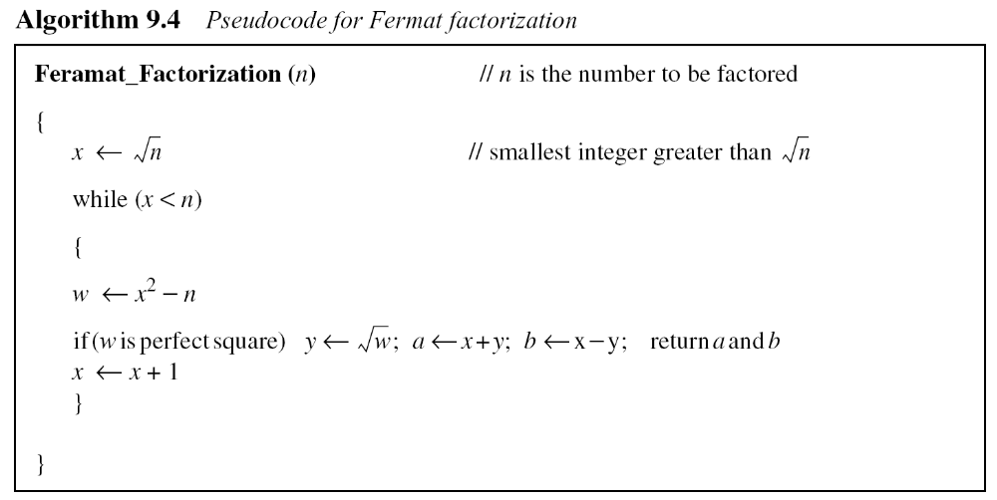
Pseudocode for Fermat factorization
Complexity of the method is close to subexponential
B C Dhara, Dept. of IT, JU

Slide 49
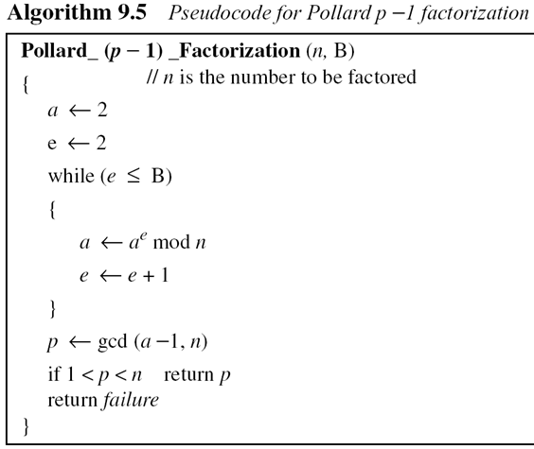
Pollard p – 1 Method
This method finds a prime factor p of a number n based on the condition that p-1 has no factor larger than B
  p = gcd(2^{B!} -1, n)
Complexity: O(2^{nb}), n_{b} is the number of bits in B
This algorithm may fail
Probability of success is very small unless B is very close to √n
B C Dhara, Dept. of IT, JU

Slide 50
Example: Pollard’s p-1 methods
Factor 1403 using pollard’s p-1 method
We take a=2 and evaluate 2^{k!} mod 1403 for k=2,3,…, then find gcd(2^{k!}-1,1403)
61 is a factor
2^{2!} ≡ 4 mod 1403 | gcd(3,1403)=1, a trivial
2^{3!} = 4³ ≡ 64 mod 1403 | gcd(63,1403)=1, a trivial
2^{4!} = 64⁴ ≡ 142 mod 1403 | gcd(141,1403)=1, a trivial
2^{5!} = 142⁵ ≡ 794 mod 1403 | gcd(793,1403)=61, a non-trivial 1403 = 61 × 23
B C Dhara, Dept. of IT, JU

Slide 51
Example: Pollard’s p-1 methods
Factor 2993 using pollard’s p-1 method
41 is a factor
2^{2!} ≡ 4 mod 2993 | gcd(3,2993)=1, a trivial
2^{3!} = 4³ ≡ 64 mod 2993 | gcd(63,2993)=1, a trivial
2^{4!} = 64⁴ ≡ 1451 mod 2993 | gcd(1450,2993)=1, a trivial
2^{5!} = 142⁵ ≡ 1395 mod 2993 | gcd(1394,2993)=41, a non-trivial 2993 = 41 × 73
B C Dhara, Dept. of IT, JU

Slide 52
Pollard rho Method
Suppose n is the number to be factored, n =pq, where p is a prime factor
  Note that p is unknown
consider two distinct numbers x1 and x2 taken from Z_{n} such that x1 ≡ x2 mod p
p | (x1 –x2) and p | n ➔ p | gcd(x1-x2, n)
p is unknown, if we compute gcd(x_{i}’-x_{j}’, n) for all pair 1≤i’ < j’ ≤ r, for some r, we will find nontrivial factor
B C Dhara, Dept. of IT, JU

Slide 53
Pollard rho Method (contd…)
Select a small random number x₁as seed
Compute x2 so that n does not divides x₁-x₂
  x₂=x₁²+1
If gcd(x₁ - x₂, n) is not trivial we get answer, STOP
If gcd ==1, select another pair of number and repeat the process until we get nontrivial gcd
List of seeds gives a repeated sequence of number on a circle, as figure in next slide
B C Dhara, Dept. of IT, JU

Slide 54
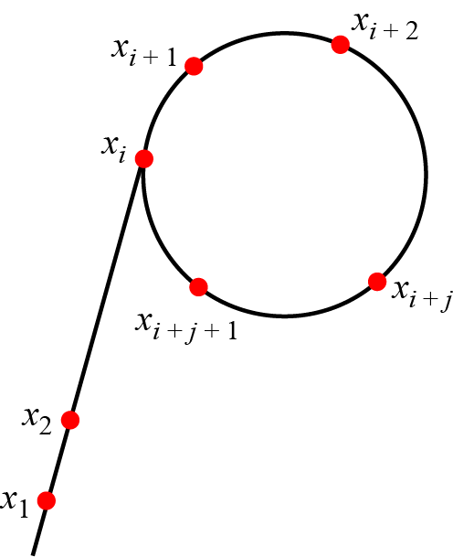
Pollard rho Method (contd…)
The figure looks like a ‘rho’
To decrease the number of iterations:
  Start with (x₀, x₀) and computes (x₁, x₂), (x₂, x₄), (x₃, x₆), …, (x_{i}, x_{2i}) using x_{i+1}=f(x_{i})
B C Dhara, Dept. of IT, JU

Slide 55
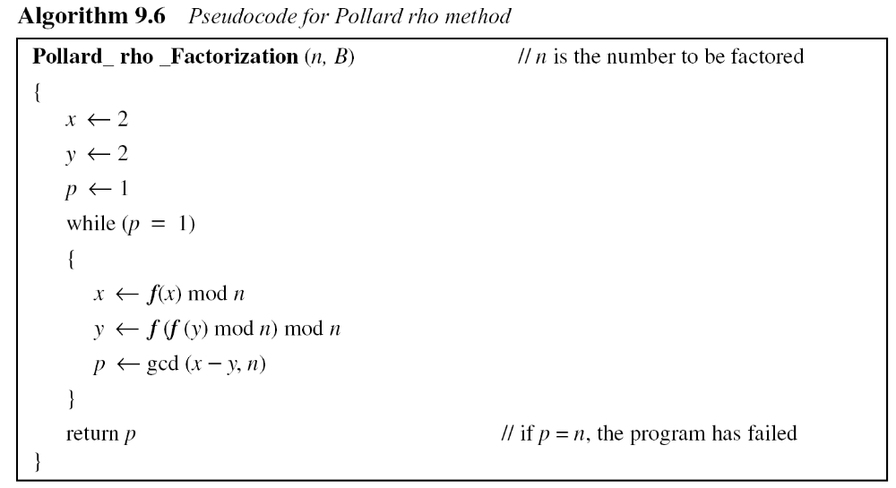
Pseudocode for Pollard rho method and Complexity
Complexity: O(2^{nb/4})
B C Dhara, Dept. of IT, JU

Slide 56
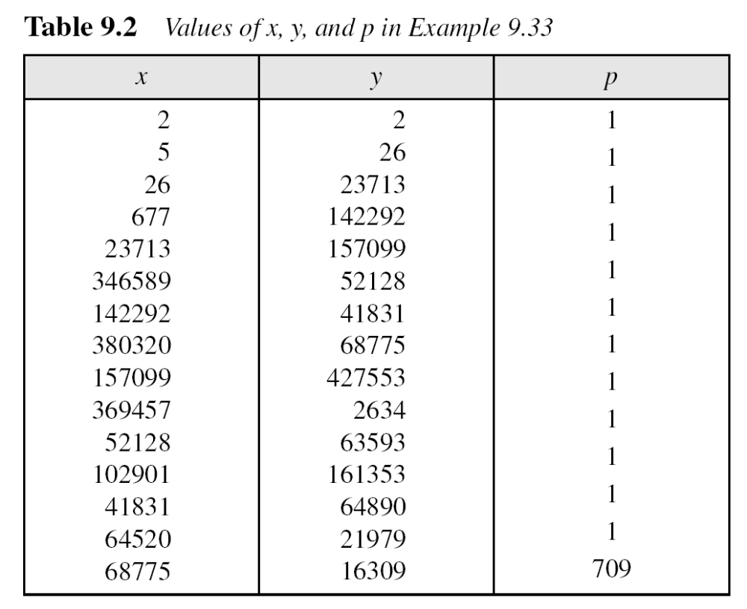
Example: Pollard rho method
Find factors of 434617. The result is 709 (434617 = 709 × 613).
B C Dhara, Dept. of IT, JU

Slide 57
Some efficient methods
Quadratic Sieve
The method uses a sieving procedure to find the value of x² mod n.
O(e^{C}), where C ≈ (ln n lnln n)^{1/2}
Number Field Sieve
The method uses a sieving procedure in an algebraic ring structure to find x² ≡ y² mod n.
O(e^{C}) where C ≈ 2 (ln n)^{1/3} (lnln n)^{2/3}
B C Dhara, Dept. of IT, JU

Slide 58
Example
Assume that there is a computer that can perform 230 (almost 1 billion) bit operations per second. What is the approximate time required for this computer to factor an integer of 100 decimal digits using one of the following methods?
a. Quadratic sieve method b. Number field sieve method
Solution
A number with 100 decimal digits has almost 300 bits (n = 2³⁰⁰). ln(2³⁰⁰) = 207 and lnln (2³⁰⁰) = 5.
a. (207)^{1/2} × (5)^{1/2} = 14 × 2.23 ≈ 32 e³² (e³²) / (2³⁰) ≈ 20 hours.
b. (207)^{1/3}× (5)^{2/2} = 6 × 3 ≈ 18. e¹⁸ (e¹⁸) / (2³⁰) ≈ 6 seconds.
9.<number>
B C Dhara, Dept. of IT, JU

Slide 59
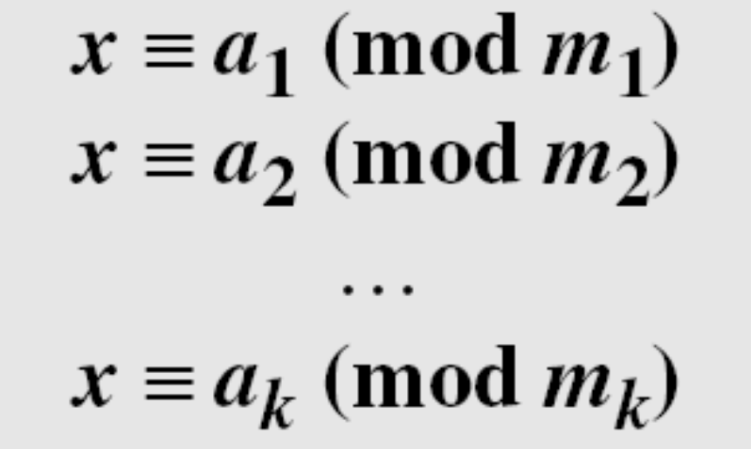
CHINESE REMAINDER THEOREM
The Chinese remainder theorem (CRT) is used to solve a set of congruent equations with one variable but different moduli, which are relatively prime, as shown below:
B C Dhara, Dept. of IT, JU

Slide 60
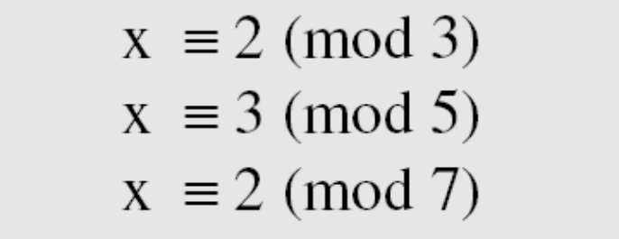
Example
The following is an example of a set of equations with different moduli:
The solution to this set of equations is given in the next section; for the moment, note that the answer to this set of equations is x = 23. This value satisfies all equations: 23 ≡ 2 (mod 3), 23 ≡ 3 (mod 5), and 23 ≡ 2 (mod 7).
B C Dhara, Dept. of IT, JU

Slide 61
Solution: Chinese Remainder Theorem
1. Find M = m₁ × m₂ × … × m_{k}. This is the common modulus.
2. Find M₁ = M/m₁, M₂ = M/m₂, …, M_{k} = M/m_{k}.
3. Find the multiplicative inverse of M_{i}, respect to modulo m_{i}, for 1 ≤ i ≤ k
Call the inverses M₁⁻¹, M₂⁻¹, …, M_{k} ⁻¹.
4. The solution to the simultaneous equations is
B C Dhara, Dept. of IT, JU

Slide 62
Example: CRT
Find the solution to the simultaneous equations:
Solution
We follow the four steps.
1. M = 3 × 5 × 7 = 105
2. M₁ = 105 / 3 = 35, M₂ = 105 / 5 = 21, M₃ = 105 / 7 = 15
3. The inverses are M₁⁻¹ = 2, M₂⁻¹ = 1, M₃ ⁻¹ = 1
4. x = (2 × 35 × 2 + 3 × 21 × 1 + 2 × 15 × 1) mod 105 = 23 mod 105
B C Dhara, Dept. of IT, JU

Slide 63
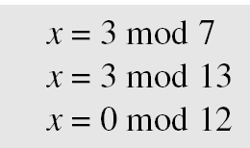
Example: CRT
Find an integer that has a remainder of 3 when divided by 7 and 13, but is divisible by 12.
Solution
This is a CRT problem. We can form three equations and solve them to find the value of x.
If we follow the four steps, we find x = 276. We can check that
276 = 3 mod 7, 276 = 3 mod 13 and 276 is divisible by 12 (the quotient is 23 and the remainder is zero).
B C Dhara, Dept. of IT, JU

Slide 64
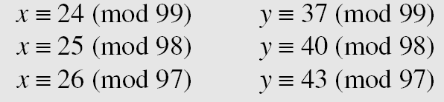
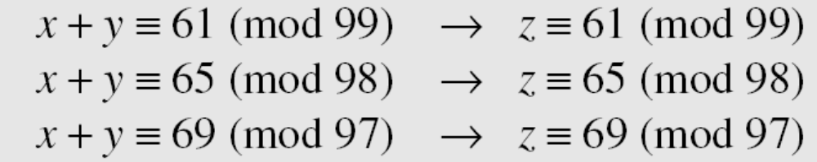
Example: CRT
Assume we need to calculate z = x + y where x = 123 and y = 334, but our system accepts only numbers less than 100. These numbers can be represented as follows:
Adding each congruence in x with the corresponding congruence in y gives
Now three equations can be solved using the Chinese remainder theorem to find z. One of the acceptable answers is z = 457.
B C Dhara, Dept. of IT, JU

Slide 65
QUADRATIC CONGRUENCE
Linear congruence ax ≡ c (mod n) or ax + b ≡ c (mod n)
In cryptography, we also need to discuss quadratic congruence⎯that is, equations of the form
a₂x² + a₁x + a₀ ≡ 0 (mod n). We limit our discussion to quadratic equations in which a₂ = 1 and a₁ = 0, that is equations of the form
x² ≡ a (mod n).
Topics discussed in this section:
Quadratic Congruence Modulo a Prime
Quadratic Congruence Modulo a Composite
B C Dhara, Dept. of IT, JU

Slide 66
Quadratic Congruence Modulo a Prime
Example 1:
The equation x² ≡ 3 (mod 11) has two solutions, x ≡ 5 (mod 11) and x ≡ −5 (mod 11). But note that −5 ≡ 6 (mod 11), so the solutions are actually 5 and 6. Also note that these two solutions are incongruent.
Example 2:
The equation x² ≡ 2 (mod 11) has no solution. No integer x can be found such that its square is 2 mod 11.
Quadratic Residues and Nonresidue
In the equation x² ≡ a (mod p), a is called a quadratic residue (QR) if the equation has two solutions; a is called quadratic nonresidue (QNR) if the equation has no solutions.
B C Dhara, Dept. of IT, JU

Slide 67
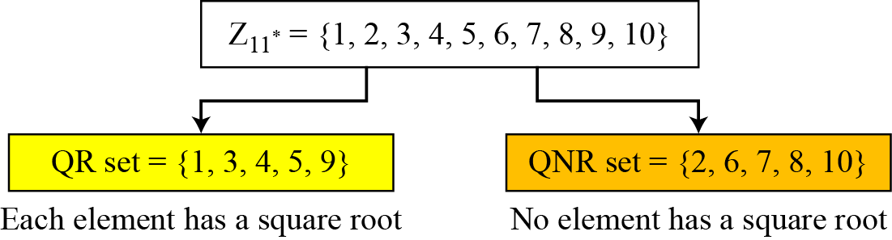
QR-QNR example
If p is prime, Z_{p}*, contains half QR and half QNR
There are 10 elements in Z₁₁*. Exactly five of them are quadratic residues and five of them are nonresidues. In other words, Z₁₁* is divided into two separate sets, QR and QNR, as shown in Figure 9.4.
Figure 9.4 Division of Z₁₁* elements into QRs and QNRs
B C Dhara, Dept. of IT, JU

Slide 68
Euler’s Criterion to check QR
If a^{(p−1)/2} ≡ 1 (mod p), a is a quadratic residue modulo p
b. If a^{(p−1)/2} ≡ −1 (mod p), a is a quadratic nonresidue modulo p
To find out if 14 or 16 is a QR in Z₂₃*, we calculate:
14 ^{(23−1)/2} mod 23 → 22 mod 23 → −1 mod 23 nonresidue
16 ^{(23−1)/2} mod 23 → 16¹¹ mod 23→ 1 mod 23 residue
B C Dhara, Dept. of IT, JU

Slide 69
Solving Quadratic Equation Modulo a Prime
Euler criteria can say if an integer a is a QR or QNR in Z_{p}*.
  Cannot find solution to x² ≡ a (mod n)
  a prime can be either p=4k+1 or p=4k+3
  Consider the case p=4k+3 and if a is QR then
B C Dhara, Dept. of IT, JU

Slide 70
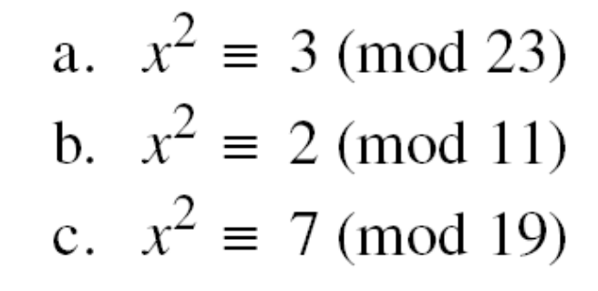
Example
Solve the following quadratic equations:
Solutions
x ≡ ± 16 (mod 23) √3 ≡ ± 16 (mod 23).
b. There is no solution for √2 in Z11.
c. x ≡ ± 11 (mod 19). √7 ≡ ± 11 (mod 19).
B C Dhara, Dept. of IT, JU

Slide 71
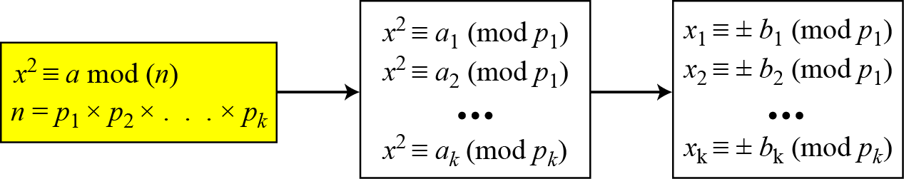
Quadratic Congruence Modulo a Composite
Can be solved by a set of congruence modulo a prime
We have factorization of n and then solve each decompose equation (if solvable)
  k pairs of solution
    2^{k} equation sets can be solved by CRT and obtained 2^{k} solutions of x
B C Dhara, Dept. of IT, JU

Slide 72
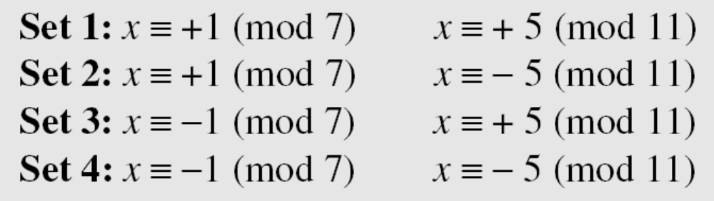
Quadratic Congruence Modulo a Composite
Assume that x² ≡ 36 (mod 77). We know that 77 = 7 × 11. We can write
The answers are x ≡ +1 (mod 7), x ≡ − 1 (mod 7), x ≡ + 5 (mod 11), and x ≡ − 5 (mod 11). Four sets of equations out of these:
-6
-27
27
6
The answers are x = ± 6 and ± 27.
Solving a quadratic congruence modulo a composite is as hard as factorization
of the modulus.
B C Dhara, Dept. of IT, JU

Slide 73
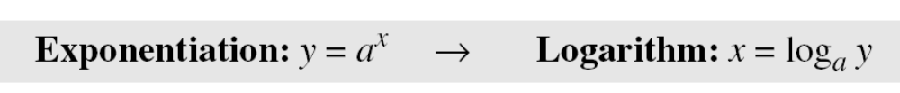
Exponentiation and Logarithm
Exponentiation and Logarithm are inverse of each other
Topics discussed in this section:
Exponentiation: modular
Logarithm: modular
B C Dhara, Dept. of IT, JU

Slide 74
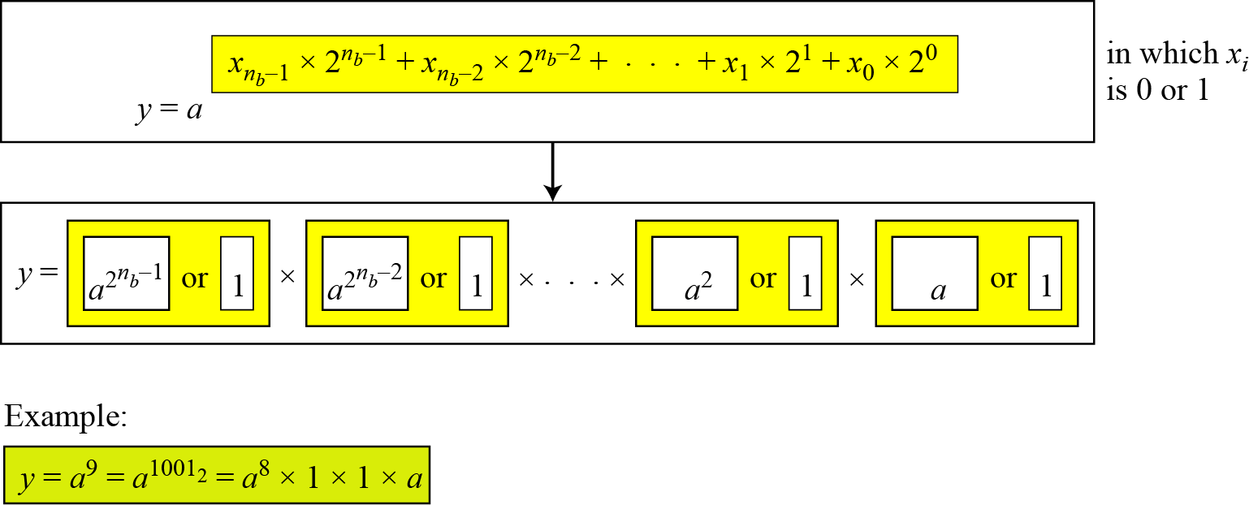
Fast exponentiation
We need a²⁰, a²¹, a²², a²³, …, a^{2i}, … // square part
If x_{i} =0 will be multiplied by 1
If x_{i} =1 will be multiplied by a^{2i}
multiplication
B C Dhara, Dept. of IT, JU

Slide 75
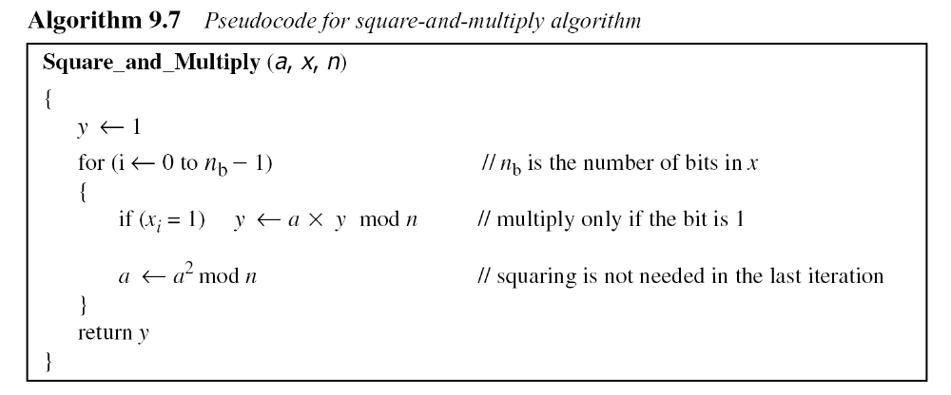
Fast exponentiation (contd…)
B C Dhara, Dept. of IT, JU

Slide 76


Example: Fast Exponentiation
The process to calculate y = a^{x} (for simplicity, modulus is not shown)
In this case, x = 22 = (10110)₂ in binary. The exponent has five bits
B C Dhara, Dept. of IT, JU

Slide 77

Logarithm
In cryptography, we also need to discuss modular logarithm.
Exhaustive search
  To solve x = log _{a} y (mod n), continuously compute y = a^{x} mod n until we find the given y
B C Dhara, Dept. of IT, JU

Slide 78
Order of the Group
What is the order of group G = <Z₂₁∗, ×>? |G| = φ(21) = φ(3) × φ(7) = 2 × 6 =12. There are 12 elements in this group: 1, 2, 4, 5, 8, 10, 11, 13, 16, 17, 19, and 20. All are relatively prime with 21.
B C Dhara, Dept. of IT, JU

Slide 79
Order of an Element
Find the order of all elements in G = <Z₁₀∗, ×>.
Solution
This group has only φ(10) = 4 elements: 1, 3, 7, 9. We can find the order of each element by trial and error.
a. 1¹ ≡ 1 mod (10) → ord(1) = 1.
b. 3⁴ ≡ 1 mod (10) → ord(3) = 4.
c. 7⁴ ≡ 1 mod (10) → ord(7) = 4.
d. 9² ≡ 1 mod (10) → ord(9) = 2.
Euler’s Theorem
If a ∈ G, then a^{φ(n)} = 1 mod n
a^{i} = 1 mod n holds when i= φ(n), it also holds for some i < φ(n)
Relation a^{i} = 1 mod n holds at least once
B C Dhara, Dept. of IT, JU

Slide 80

Order of an Element
Euler’s Theorem
If a ∈ G, then a^{φ(n)} = 1 mod n
a^{i} = 1 mod n holds when i= φ(n), it also holds for some i < φ(n)
Relation a^{i} = 1 mod n holds at least once
G = <Z₈∗, ×>.
B C Dhara, Dept. of IT, JU

Slide 81

Primitive Roots
In the group G = <Z_{n}∗, ×>, when the order of an element is the same as φ(n), that element is called the primitive root of the group
There are no primitive roots in G = <Z₈∗, ×> because no element has the order equal to φ(8) = 4. The order of elements are all smaller than 4.
The result of a^{i} ≡ x (mod 7) for the group G = <Z₇∗, ×>. In this group, φ(7) = 6.
B C Dhara, Dept. of IT, JU

Slide 82
Primitive Roots (contd…)
The group G = <Z_{n}*, ×> has primitive roots only if n is 2, 4, p^{t}, or 2p^{t}.
For which value of n, does the group G = <Z_{n}∗, ×> have primitive roots: 17, 20, 38, and 50?
Solution
G = <Z₁₇∗, ×> has primitive roots, 17 is a prime.
b. G = <Z₂₀∗, ×> has no primitive roots.
c. G = <Z₃₈∗, ×> has primitive roots, 38 = 2 × 19 prime.
d. G = <Z₅₀∗, ×> has primitive roots, 50 = 2 × 5² and 5 is a prime.
If the group G = <Z_{n}*, ×> has any primitive root, the number of primitive roots is φ(φ(n)).
B C Dhara, Dept. of IT, JU

Slide 83
Primitive Roots (contd…)
Given a group G = <Z_{n}*, ×> , how can we check whether a is a primitive root of G?
Given a group G = <Z_{n}*, ×> , how can we check all primitive roots of G?
Given a group G = <Z_{n}*, ×> , how can we select a primitive root?
B C Dhara, Dept. of IT, JU

Slide 84

Cyclic group
Cyclic Group: If g is a primitive root in the group, we can generate the set Z_{n}* as Z_{n}∗ = {g¹, g², g³, …, g^{φ(n)}}
The group G = <Z₁₀*, ×> has two primitive roots because φ(10) = 4 and φ(φ(10)) = 2. It can be found that the primitive roots are 3 and 7. The following shows how we can create the whole set Z₁₀* using each primitive root.
B C Dhara, Dept. of IT, JU

Slide 85
The idea of Discrete Logarithm
Properties of G = <Z_{p}*, ×> :
1. Its elements include all integers from 1 to p − 1.
2. It always has primitive roots.
3. It is cyclic. The elements can be created using g^{x} where
x is an integer from 1 to φ(n) = p − 1.
4. The primitive roots can be thought as the base of logarithm.
B C Dhara, Dept. of IT, JU

Slide 86

Solution to Modular Logarithm Using Discrete Logs
Tabulation of Discrete Logarithms: table is pre-calculated and saved
y
Find x in each of the following cases:
a. 4 ≡ 3^{x} (mod 7).
b. 6 ≡ 5^{x} (mod 7).
Solution
We can easily use the tabulation of the discrete logarithm in Table 9.6.
a. 4 ≡ 3^{x} mod 7 → x = L₃4 mod 7 = 4 mod 7
b. 6 ≡ 5^{x} mod 7 → x = L₅6 mod 7 = 3 mod 7
B C Dhara, Dept. of IT, JU

Slide 87

Solution to Modular Logarithm Using Discrete Logs
Using Properties of Discrete Logarithms
Tabulation and properties of discrete logarithms cannot be used when n is very large
The discrete logarithm problem has the same complexity as the factorization problem.
B C Dhara, Dept. of IT, JU

